Slide 1

Indian Institute of Information Techonlogy Pune
Department of Computer Science Engineering
2022-2023
Machine Learning Project
on
“Stock Market Prediction using Machine Learning and Python”
By
G. Manoj Reddy (112015054)
R. Suraj Rao (112015108)
U. Vinod Kumar (112015158)
V. Bharadwaj (112015160)
Mentor :- Amruta Lipare

Slide 2
Stock Market Prediction
using
Machine Learning and Python
Problem Statement: This Project is based on Machine learning algorithms like Linear Regression , Moving Average , Decision Tree to predict the stock market prices.

Slide 3
Outline
Introduction
Algorithms used
Methodology
Flow chart
Code
Experiment result
Conclusion
References

Slide 4
Introduction
Predicting how the stock market will perform is one of the most difficult things to do. There are so many factors involved in the prediction – physical factors vs. physiological, rational and irrational behavior, etc. All these aspects combine to make share prices volatile and very difficult to predict with a high degree of accuracy.
It is to determine the calculation of market closing index for a given trading day efficiently such that the customer can decide whether to buy or sell or hold.
Here comes Machine Learning as a game changer in this domain. Using features like the latest announcements about an organization, their quarterly revenue results, etc., machine learning techniques have the potential to unearth patterns and insights we didn’t see before, and these can be used to make accurate predictions.

Slide 5
Algorithms used
Linear Regression
Decision Tree
Moving average

Slide 6
Linear Regression
Linear regression is a statistical approach that models the relationship between input features and output.
The purpose of the linear regression function is to find a line that is closest from all data points so that whenever we want to calculate the prediction for a new dependent variable we can pick the subsequent point on the line corresponding to the independent variable on X axis.
We predicted the output based on only one input feature.
Simple linear regression is given by
y = m*x + c
Where ‘c’ = constant or y intercept of line
‘m’ = coefficient of input feature
‘x’ = input feature in which output is based
‘y’ = output

Slide 7
Decision Tree
Decision trees in Machine Learning are used for building classification and regression models to be used in data mining and trading.
A decision tree algorithm performs a set of recursive actions before it arrives at the end result and when you plot these actions on a screen, the visual looks like a big tree, hence the name ‘Decision Tree’.
Basically, a decision tree is a flowchart to help you make decisions. Machine Learning uses the same technique to make better decisions
In stock market prediction we use decision tree by classifying closing price considering remaining attributes like open price ,high price ,low price ,volume etc.,

Slide 8
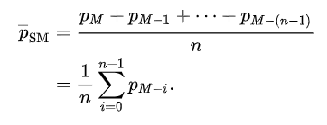

Moving Average
The predicted closing price for each day will be the average of a set of previously observed values.
Instead of using the simple average, we will be using the moving average technique which uses the latest set of values for each prediction.
In other words, for each subsequent step, the predicted values are taken into consideration.
It is an equally weighted mean of previous n data.
Here we use the formula:
closing prices are Pm,Pm-1,……Pm-(n-1),
‘Psm’ is the average of previous values
When calculating successive values, a new value comes into the sum, and the oldest value drops out, meaning that a full summation each time is unnecessary for this simple case:

Slide 9
Methodology
First we imported all libraries that are required such as pandas , numpy ,sklearn ,matplotlib.
Next we read the data using panadas library from .csv file
Then Visualized the data and get the closing price from data and created a variable to predict ‘x’ days out into the future.
Now we created the target data and split the data into training and testing datasets.
There after we implemented the models like decision tree , linear regression and printed the predicted values respectively and plotted the predicted values against original ones.
For Moving average technique we again loaded the data and defined the moving average function and printed the predicted values for each day and plotted them in graph against original data.

Slide 10
Flow Charts
Linear Regression model
Decision Tree Model
Stock Movements
Correct Output
Start
Stop
Display the output
Read stock data
Input data
Target data
Test the system using testing dataset
Calculate dependent variable
Machine learning
Algorithm
Train the system using training dataset
Calculate indicator variable
Regression based model
Create input data frame
Divide data set into testing and training dataset
Prediction

Slide 11
Moving Average Model
Start
Read the data from stock
Apply moving average algorithm on closing price
Display the stock of averages
Stop

Slide 12
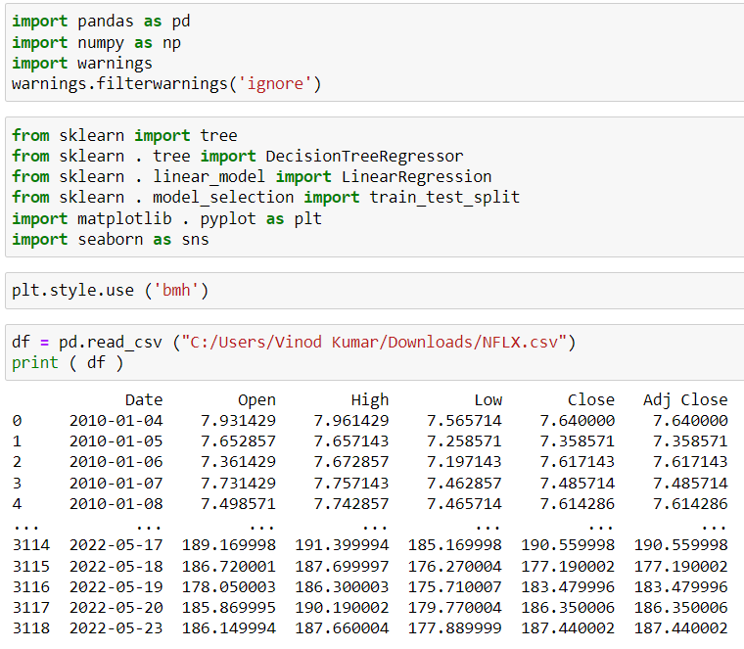
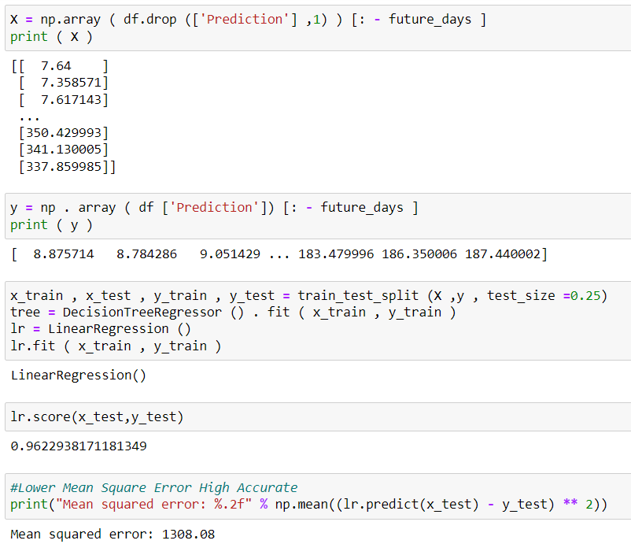
CODE

Slide 13
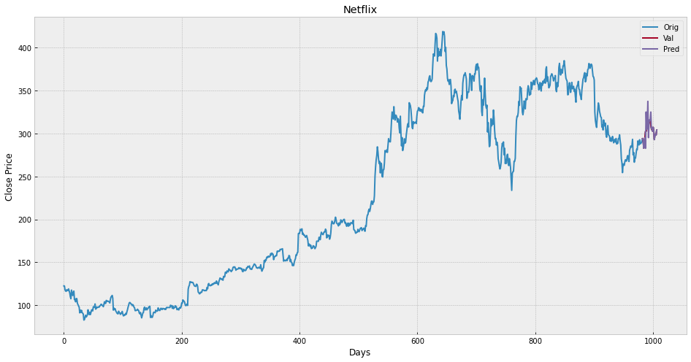
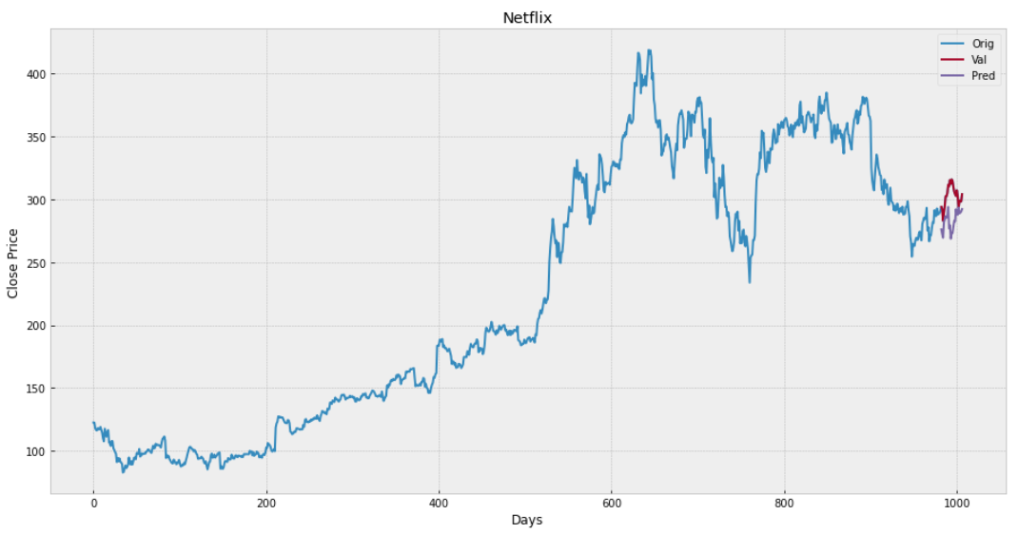
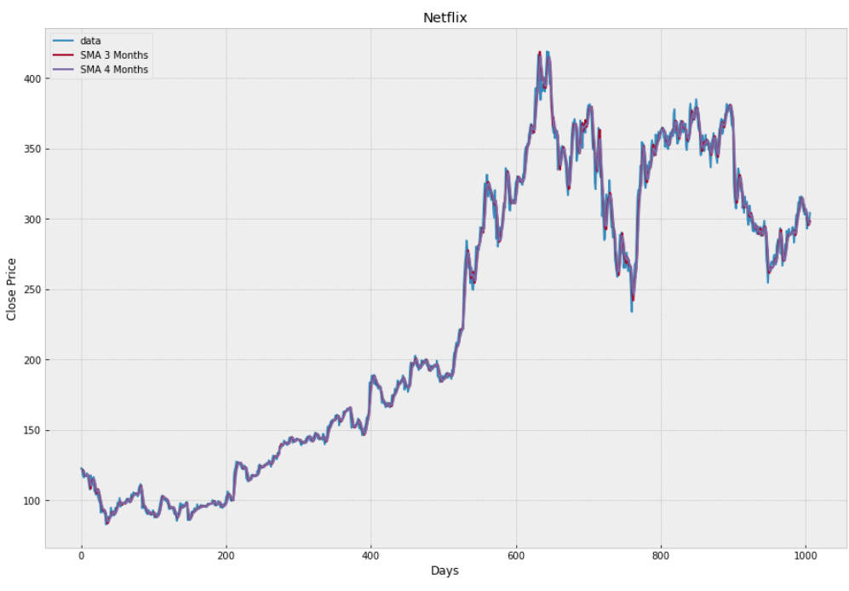
Experiment Results
The proposed system is trained and tested over the dataset taken from Netflix company. It is split into training and testing sets respectively and yields the following results upon passing through the different models
Result for Decision Tree
Result for Linear regression
Result for moving average
The plot in the above figures is the result of application of Decision tree ,linear
regression ,simple moving average algorithms on the dataset to predict varying
prices with respect to the time.

Slide 14
Conclusion
Three techniques have been utilized in this project Decision Tree ,Linear Regression , Moving Average, on the Netflix dataset. These all techniques have shown an improvement in the accuracy of predictions, thereby yielding positive results.
Use of recently introduced machine learning techniques in the prediction of stocks have yielded promising results and thereby marked the use of them in profitable exchange schemes.
In the future, the stock market prediction system can be further improved by utilizing a much bigger dataset than the one being utilized currently. This would help to increase the accuracy of our prediction models.
It has led to the conclusion that it is possible to predict stock market with more accuracy and efficiency using machine learning techniques.

